Slide 1
Pet PickThrough
Project Group #12
Jagadish Tirumalasetty
Surya Botcha
Kailash
Kishore

Slide 2
Project Motivation
When ever we loose a pet we just never have an idea where to start looking from.
This app tries to give a possible location to start with based on the incidents reported by people.
In case any incident is logged with KCMO you can see the incident details and reduce your effort if you are to start with your search.

Slide 3
Project Idea
The idea of our app was to allow users to look through KCMO public data records to see if any record matching to their missing pets.
Targeted at users who have lost their pets.
App usage might not be for repeated users but for impulsive ones.

Slide 4
Platforms Used and Data
Android sdk with ADT
Bluemix Mobile Cloud
Data Set Reference
https://data.kcmo.org/

Slide 5
Architecture
KCMO Data Store
Bluemix Mobile App Data
Mobile App

Slide 6
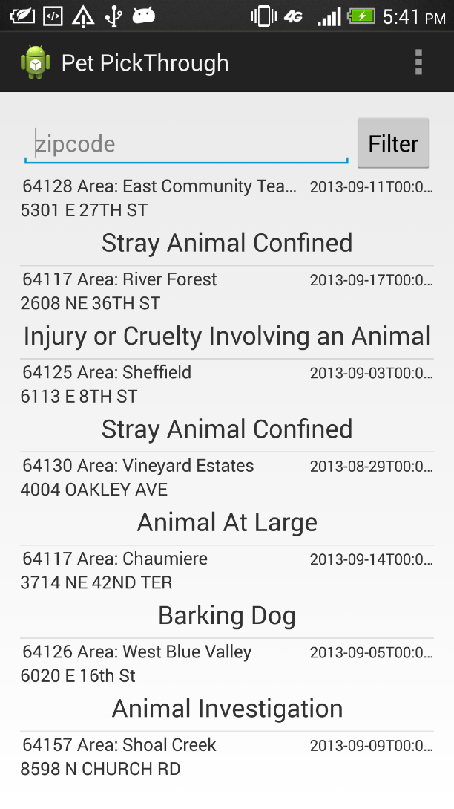
Application Demo

Slide 7
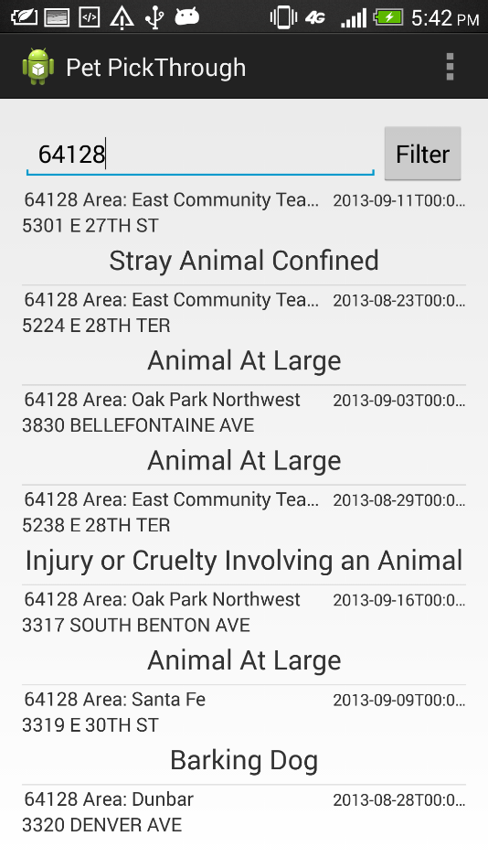
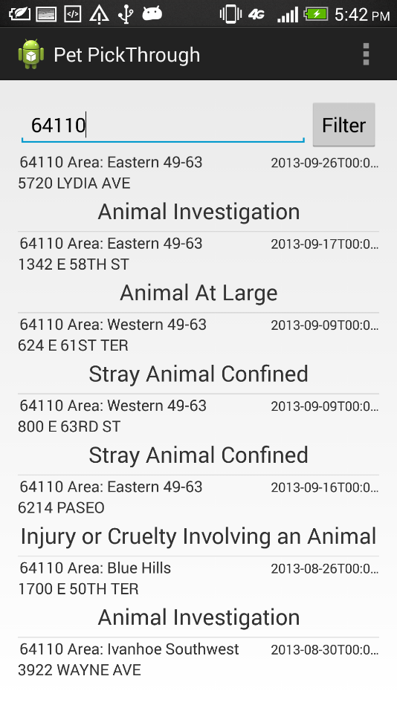
Demo

Slide 8
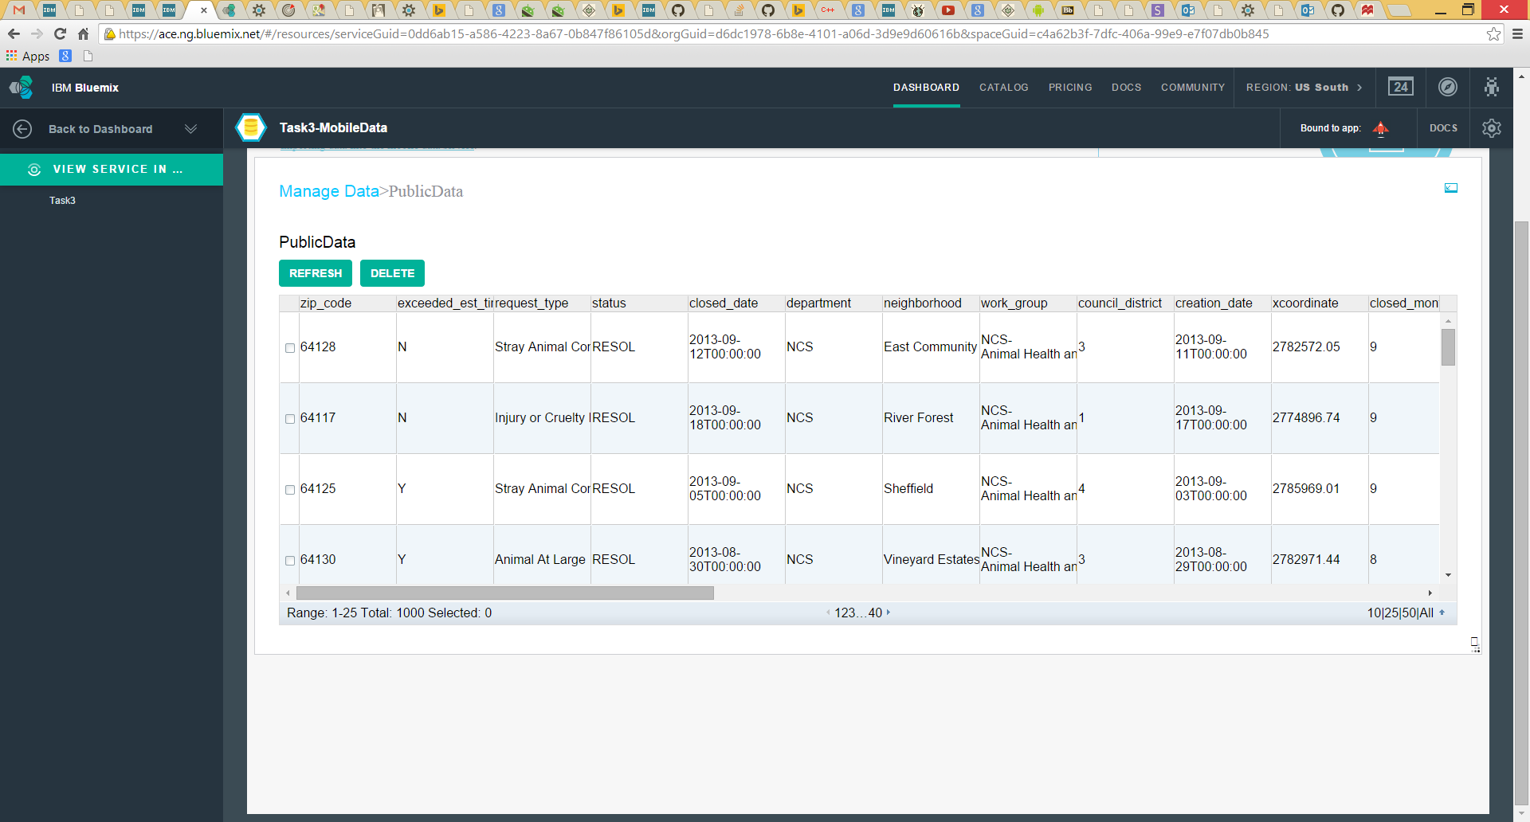
Data Set

Slide 9
Queries

